Slide 1
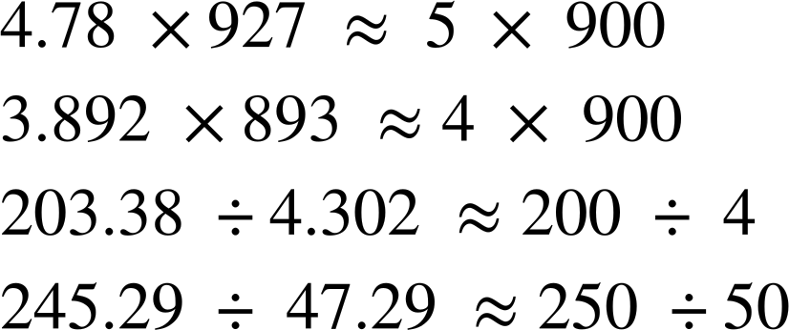

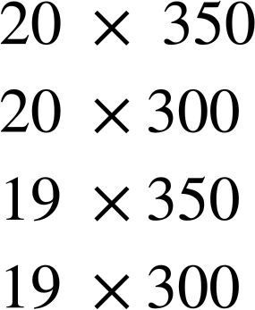
Estimating numerical calculations
Task A: Estimating using significant figures
1) Fill in the gaps to make the approximations correct. You can only use each number once.
a)
b)
c)
d)
2) To estimate this,
a) Which of these calculations would you use? Explain your choice.
b) Which of these gives the closest estimate?
c) Which gives the estimate that is furthest away?

Slide 2
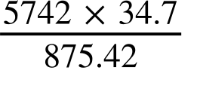
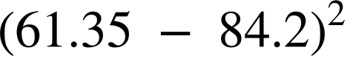
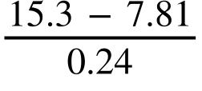

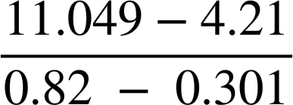
Estimating numerical calculations
3) Estimate the following, making sure to show your working out.
e.g.
a)
b)
c)
d)
e)
f)

Slide 3
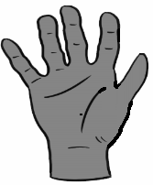
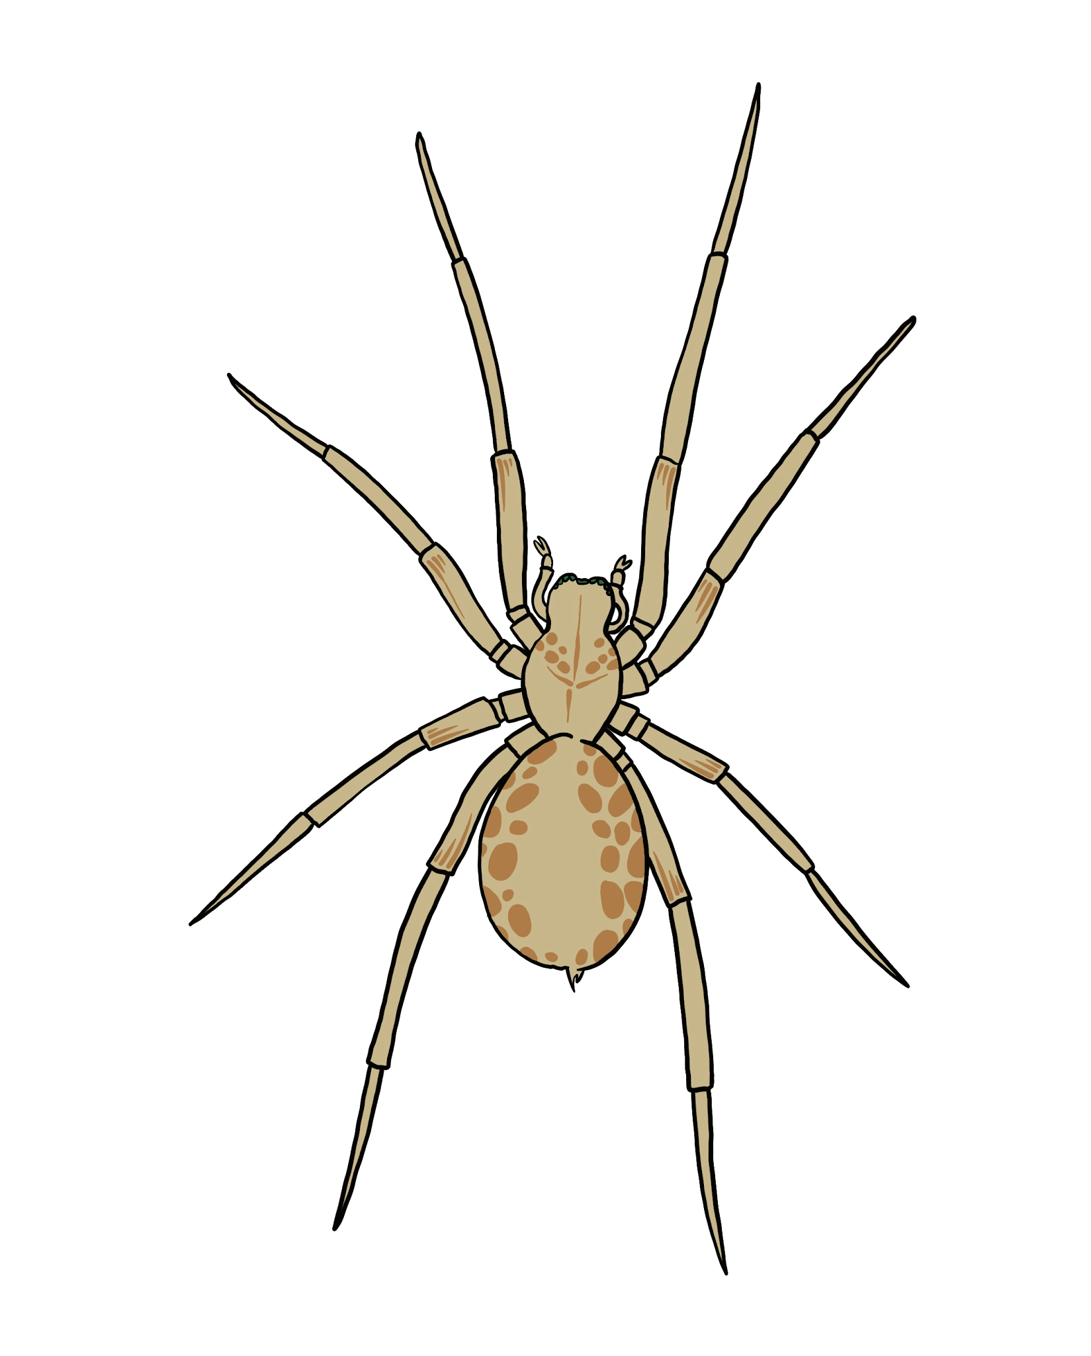
Estimating numerical calculations
Task B: Estimation in context
A science textbook uses comparisons with humans to show the sizes of different animals.
Which of these is a good estimate for the width of the hand?
10 cm 25 cm 5 cm
Use your answer to part a to estimate the size of the animals below.
b)
🐀
c)
Length
Length
2) a) What would be a sensible unit of mass to measure each of the items in the table?
b) Each of the values below matches one of the six items. Which is which?
baby | elephant | full suitcase
cargo ship container | newborn puppy | packet of crisps
4000 | 3.2 | 120 | 28 | 19 | 2797
c) An orange weighs approximately 120 g. How many oranges do you think would be the equivalent of one of each of the things in part a?

Slide 4
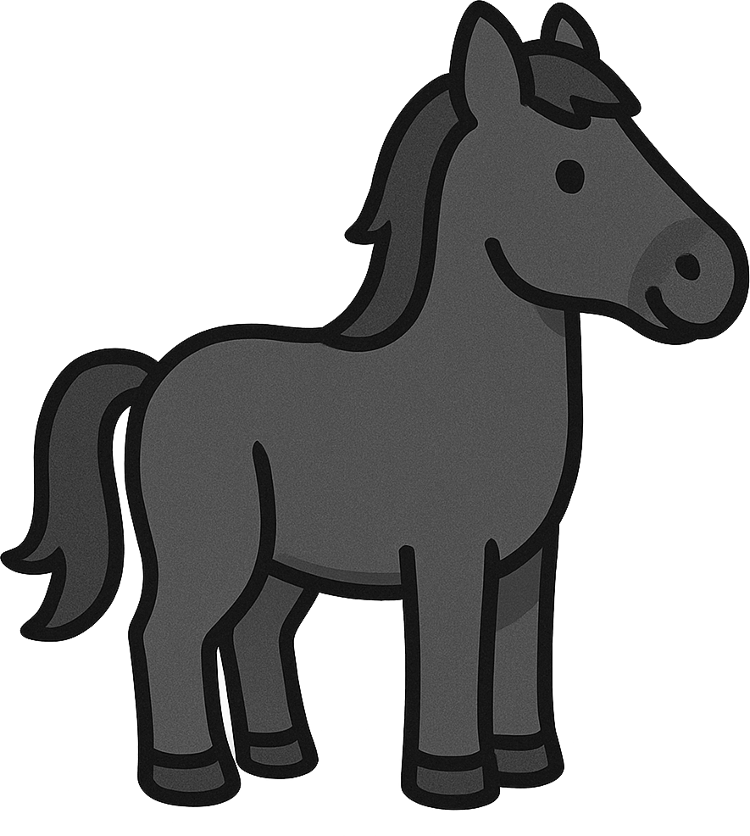
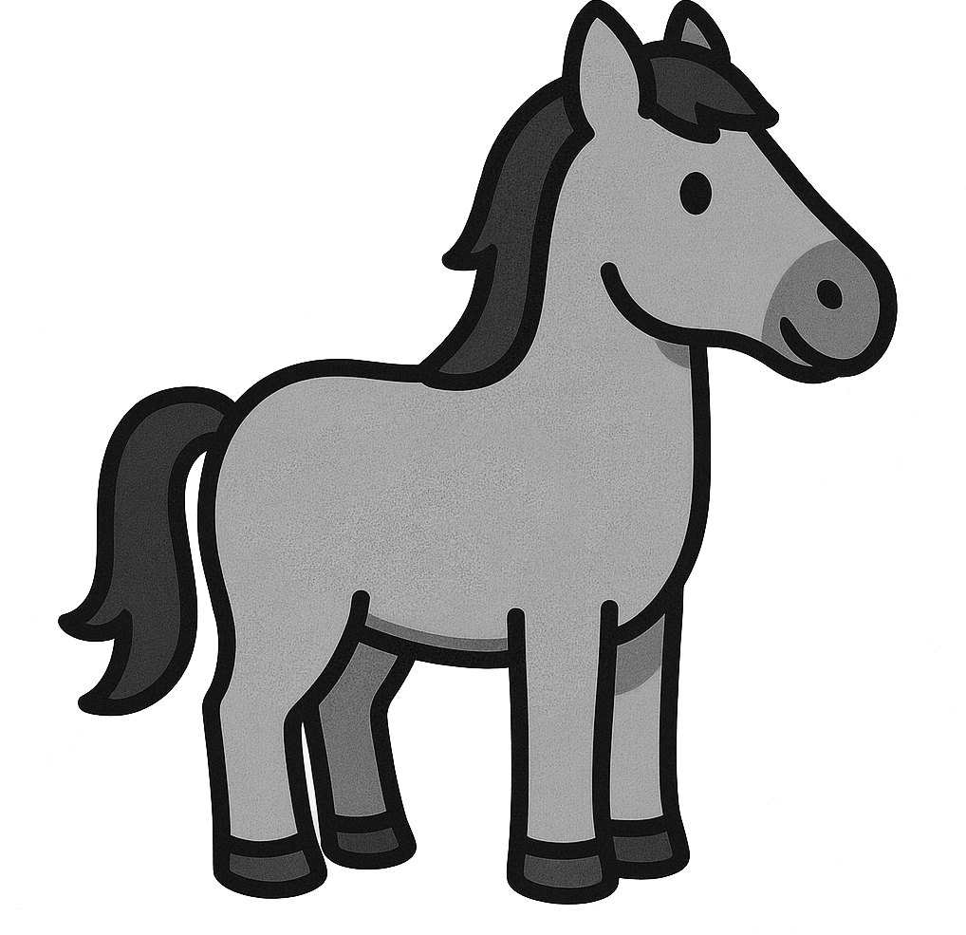
Estimating numerical calculations
3) Horses are measured using ‘hands’ as a unit, as shown below.
a) Estimate the height in centimetres of each of the horses.
b) The standard metric equivalent for a hand is 10.2 cm. Does this mean your estimate will be too big, too small or just right?
c) How many hands high are you to the top of your head?
d) Estimate some other objects using hands as a unit.
Mathematics in Education and Industry
v2.3

